Slide 1
Today: Views, Stored Procedures, Functions, and Triggers

Slide 2
Views in SQL
A view is a “virtual” table that is derived from other tables
Allows for limited update operations
Since the table may not physically be stored
Allows full query operations

Slide 3
SQL Views: An Example
Create a view for Students that Applied to OSU:
CREATE VIEW OSUApplicants AS SELECT Distinct Student.sID, sName, GPA FROM Student, Apply
WHERE Student.sID= Apply.sID AND Apply.cName=‘OSU’;
Find OSU Applicants with GPA > 3.5
SELECT sID, sName
FROM OSUApplicants
WHERE GPA > 3.5
When no longer needed, a view can be dropped:
DROP VIEW OSUApplicants;

Slide 4
Update Views
Update on a view can be implemented by mapping it to an update on the underlying base table
UPDATE MANAGER SET Salary = 1.1*Salary WHERE Dname = ‘Research’;
Becomes:
UPDATE EMPLOYEE SET Salary = 1.1*Salary WHERE SSN in (SELECT MgrSSN FROM DEPARTMENT WHERE DName = ‘Research’);
Updating views involving joins are not always possible
Views defined using groups and aggregate functions are not updateable
For MySQL, the keyword “WITH CHECK OPTION” must be added to the view definition if the view is to be updated. However many restrictions in MySQL

Slide 5
SQL Triggers
To monitor a database and take a corrective action when a condition occurs
Examples:
Update GPA when a new grade is entered.
Limit the salary increase of an employee to no more than 5% raise
CREATE TRIGGER trigger-name trigger-time trigger-event ON table-name FOR EACH ROW trigger-action;
trigger-time ∈ {BEFORE, AFTER}
trigger-event ∈ {INSERT,DELETE,UPDATE}

Slide 6
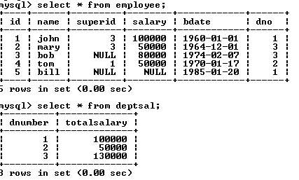
SQL Triggers: An Example
We want to create a trigger to update the total salary of a department when a new employee is hired

Slide 7
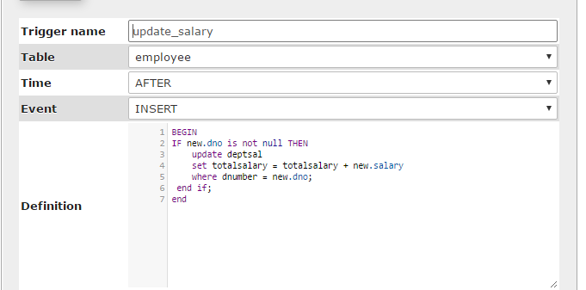
SQL Triggers: An Example
Create a trigger to update the total salary of a department when a new employee is hired:
The keyword “new” refers to the new row inserted

Slide 8
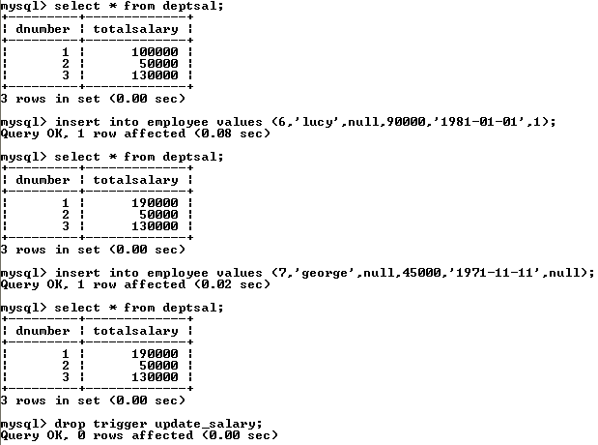
SQL Triggers: An Example
totalsalary increases by 90K
totalsalary did not change

Slide 9
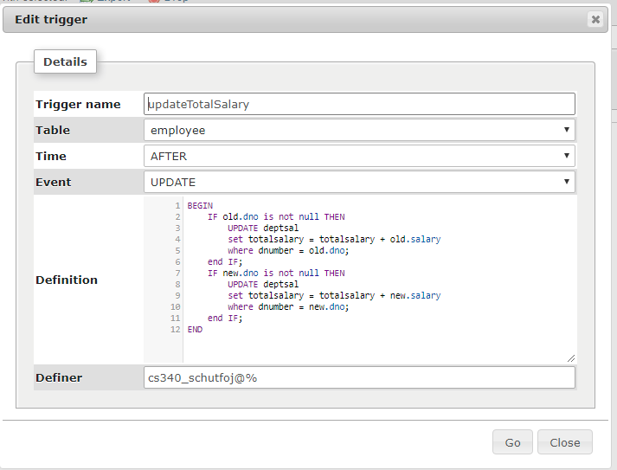
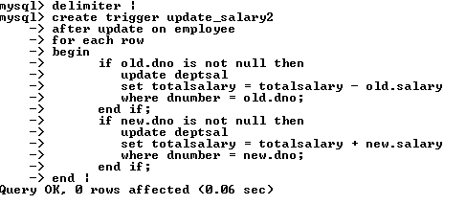
SQL Triggers: An Example
A trigger to update the total salary of a department when an employee tuple is modified:

Slide 10
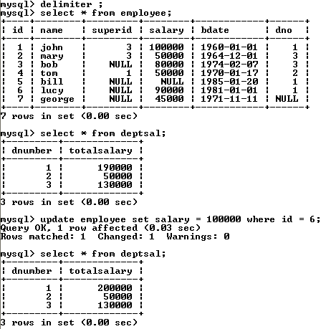
SQL Triggers: An Example

Slide 11
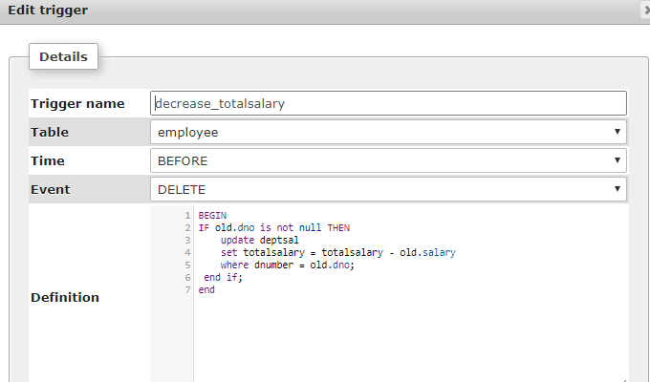
SQL Triggers: An Example
A trigger to decrease the total salary of a department when an employee tuple is deleted:

Slide 12
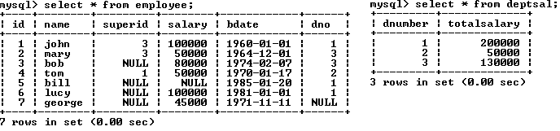
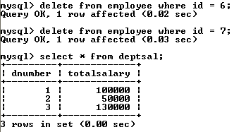
SQL Triggers: An Example

Slide 13
Stored Procedures in MySQL
A stored procedure contains a sequence of SQL commands stored in the database catalog so that it can be invoked later by a program
Stored procedures are declared using the following syntax:
Create Procedure <proc-name>
(param_spec₁, param_spec₂, …, param_spec_{n} )
begin
-- execution code
end;
where each param_spec is of the form:
[in | out | inout] <param_name> <param_type>
in mode: allows you to pass values into the procedure,
out mode: allows you to pass value back from procedure to the calling program

Slide 14
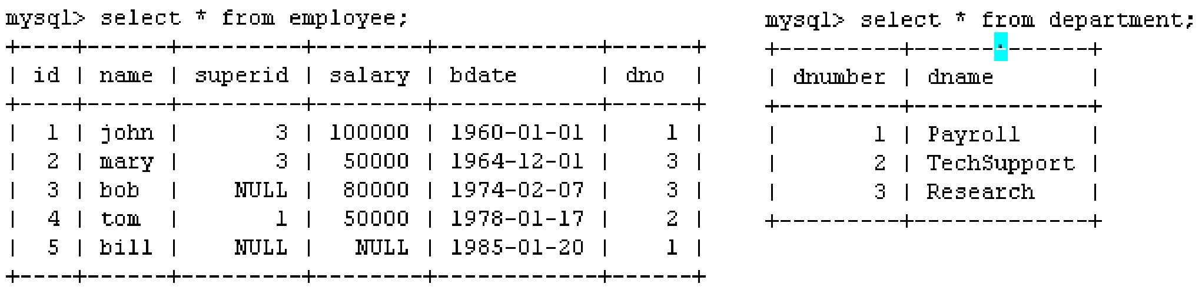
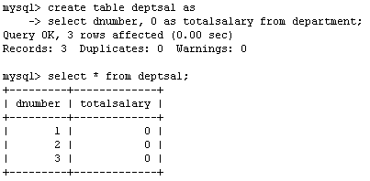
Example
Suppose we want to keep track of the total salaries of employees working for each department
We need to write a procedure to update the salaries in the deptsal table

Slide 15
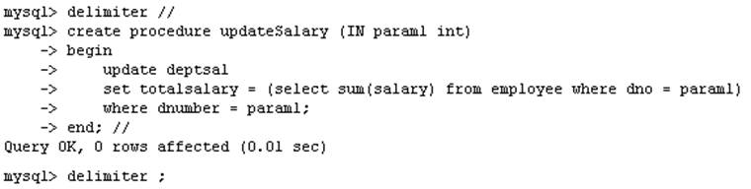
Example
Step 1: Change the delimiter (i.e., terminating character) of SQL statement from semicolon (;) to something else (e.g., //)
So that you can distinguish between the semicolon of the SQL statements in the procedure and the terminating character of the procedure definition

Slide 16
Example
Step 2:
Define a procedure called updateSalary which takes as input a department number.
The body of the procedure is an SQL command to update the totalsalary column of the deptsal table.
Terminate the procedure definition using the delimiter you had defined in step 1 (//)

Slide 17
Example
Step 3: Change the delimiter back to semicolon (;)

Slide 18
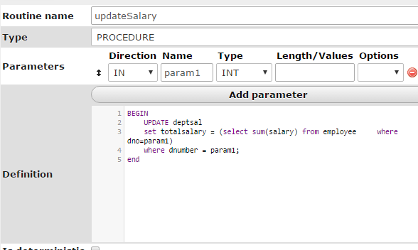

Slide 19
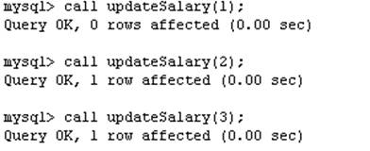
Example
Step 4: Call the procedure to update the totalsalary for each department

Slide 20
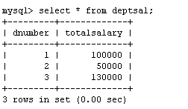
Example
Step 5: Show the updated total salary in the deptsal table

Slide 21
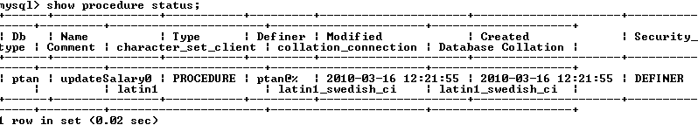

Stored Procedures in MySQL
Use show procedure status to display the list of stored procedures you have created
Use drop procedure to remove a stored procedure

Slide 22
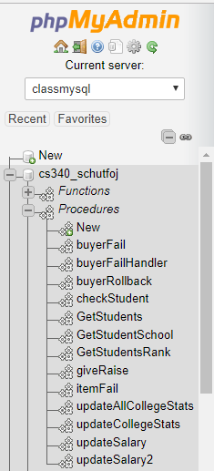
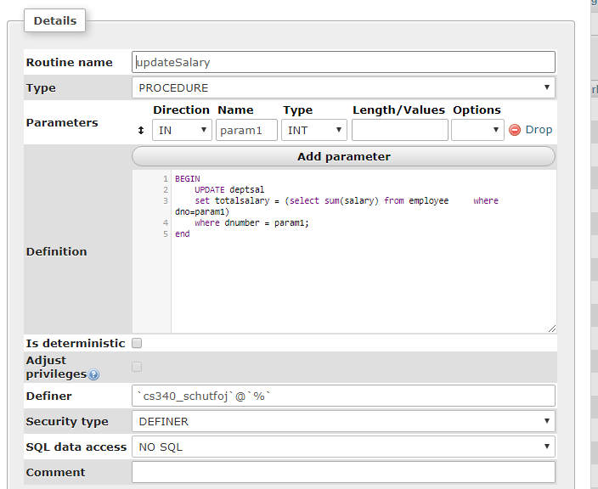

Slide 23
Stored Procedures in MySQL
You can declare variables in stored procedures
You can use flow control statements (conditional IF-THEN-ELSE or loops such as WHILE and REPEAT)
MySQL also supports cursors in stored procedures.
A cursor is used to iterate through a set of rows returned by a query so that we can process each individual row.
To learn more about stored procedures, go to:
http://www.mysqltutorial.org/mysql-stored-procedure-tutorial.aspx

Slide 24
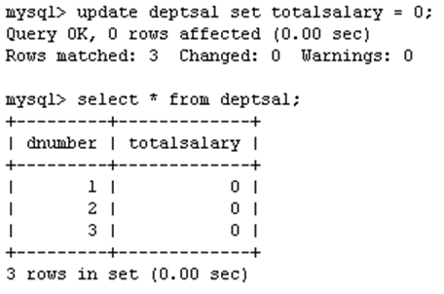
Example using Cursors:
a cursor is a control structure that enables traversal over the records in a database
The previous procedure updates one row in deptsal table based on input parameter
Suppose we want to update all the rows in deptsal simultaneously
First, let’s reset the totalsalary in deptsal to zero

Slide 25
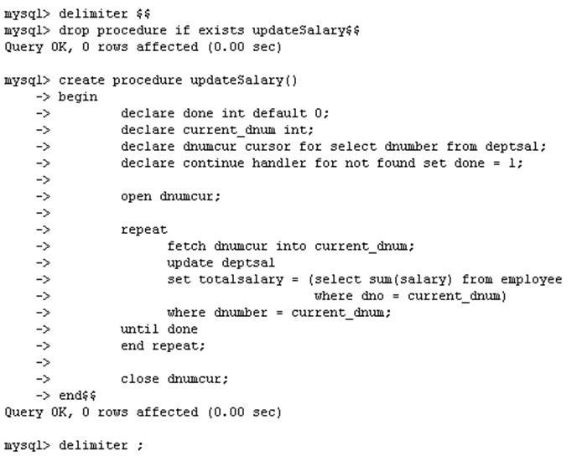
Example using Cursors
Drop the old procedure
Use cursor to iterate the rows

Slide 26
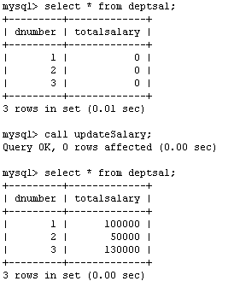
Example using Cursors
Call procedure

Slide 27
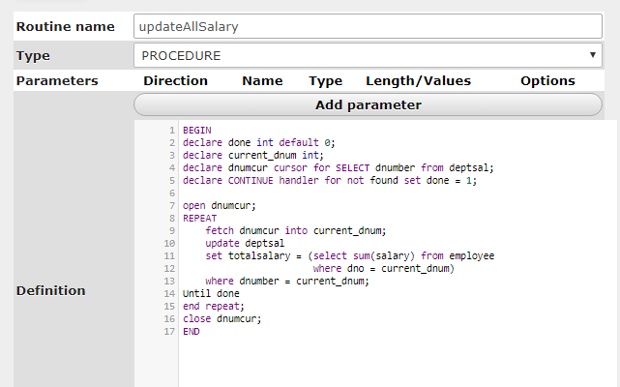

Slide 28
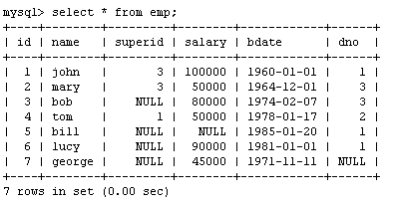
Another Example
Create a procedure to give a raise to all employees

Slide 29
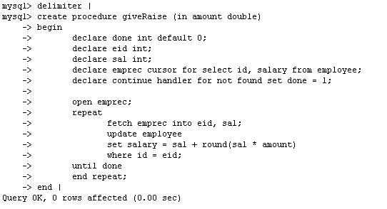
Another Example

Slide 30
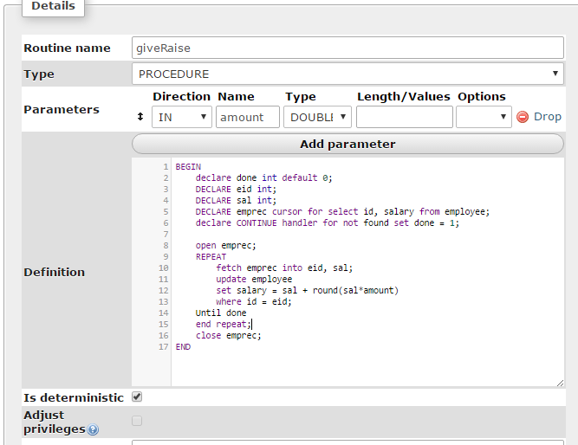

Slide 31
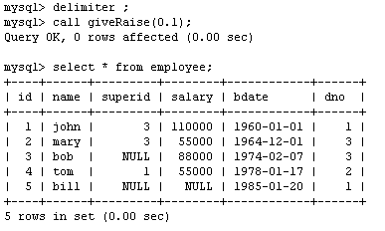
Another Example

Slide 32
Functions
Functions are declared using the following syntax:
function <function-name> (param_spec₁, …, param_spec_{k})
returns <return_type>
[not] deterministic allow optimization if same output
for the same input (use RAND not deterministic )
Begin
-- execution code
end;
where param_spec is:
[in | out | in out] <param_name> <param_type>
You need ADMIN privilege to create functions on mysql-user server

Slide 33
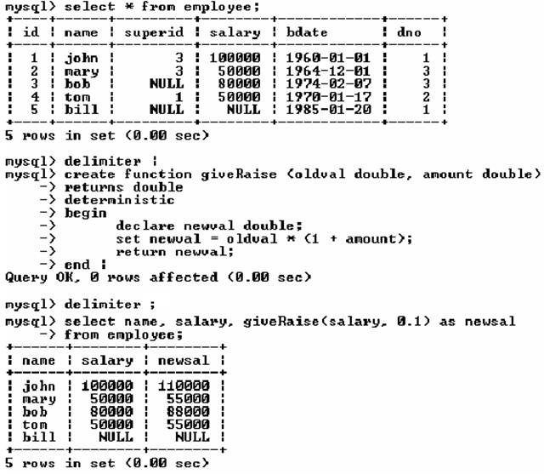
Example of Functions

Slide 34
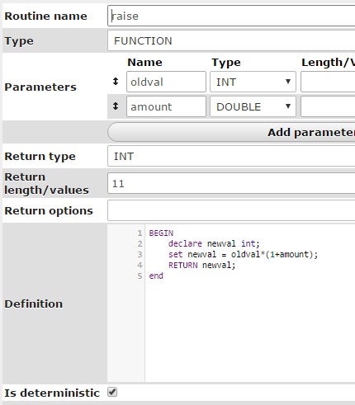

Slide 35
Example of Functions

Slide 36
Assertions – Not supported in MySQL
CREATE ASSERTION defines a new rule that will constrain the set of valid values for one or more Base tables. Assertion is owned by the Schema it belongs to.
CREATE ASSERTION <Constraint name>
CHECK (search condition)
[ <constraint attributes> ]

